Slide 1
Table 1: Average Preprandial Volumetric Flow Rates (mL/min/kg)
 | SCAo | IRAo | LRA | RRA | SMA | CA | SMV | SV | PV
Control | 48.2 ± 17.6 | 15.5 ± 7.81 | 5.00 ± 3.40 | 4.85 ± 2.42 | 5.97 ± 3.15 | 11.8 ± 7.88 | 6.61 ± 2.66 | 6.52 ± 4.18 | 14.1 ± 5.57
CMI- | 44.6 ± 15.6 | 16.5 ± 6.50 | 6.40 ± 2.73 | 6.18 ± 2.99 | 8.04 ± 4.35 | 6.72 ± 3.54 | 6.89 ± 4.14 | 6.46 ± 3.63 | 13.5 ± 4.40
CMI+ | 36.5 ± 10.4 | 19.1 ± 3.88 | 6.68 ± 8.44 | 6.01 ± 6.37 | 7.59 ± 3.13 | 7.80 ± 3.51 | 10.7 ± 3.64 | 5.21 ± 1.89 | 17.7 ± 5.71
Volumetric flow rates are expressed as mean ± 1 standard deviation. Bold indicates statistical significance (p < 0.05) compared to controls. Underline indicates statistical significance (p < 0.05) between CMI and Neg. Diag. group. SCAo = supraceliac aorta, IRAo = infrarenal aorta, LRA = left renal artery, RRA = right renal artery, SMA = superior mesenteric artery, CA = celiac artery, SMV = superior mesenteric vein, SV = splenic vein, and PV = portal vein.

Slide 2
Table 2: Average Postprandial Volumetric Flow Rates (mL/min/kg)
 | SCAo | IRAo | LRA | RRA | SMA | CA | SMV | SV | PV
Control | 55.3 ± 19.9 | 14.0 ± 6.15 | 4.94 ± 2.91 | 5.21 ± 2.72 | 11.1 ± 5.00 | 11.0 ± 7.00 | 14.2 ± 4.56 | 5.80 ± 2.52 | 20.6 ± 5.91
CMI- | 54.2 ± 22.3 | 19.3 ± 6.93 | 6.33 ± 2.74 | 6.33 ± 3.70 | 12.5 ± 6.40 | 7.00 ± 4.42 | 16.7 ± 7.23 | 5.94 ± 3.85 | 23.1 ± 6.56
CMI+ | 35.3 ± 11.3 | 18.6 ± 7.00 | 6.37 ± 9.29 | 3.82 ± 4.18 | 9.37 ± 4.52 | 8.17 ± 3.96 | 15.5 ± 8.60 | 4.46 ± 1.67 | 20.8 ± 10.3
Volumetric flow rates are expressed as mean ± 1 standard deviation. Bold indicates statistical significance (p < 0.05) compared to controls. Underline indicates statistical significance (p < 0.05) between the CMI- and CMI+ group. SCAo = supraceliac aorta, IRAo = infrarenal aorta, LRA = left renal artery, RRA = right renal artery, SMA = superior mesenteric artery, CA = celiac artery, SMV = superior mesenteric vein, SV = splenic vein, and PV = portal vein.

Slide 3
Table 3: Average Percent Change in Flow (%)
 | SCAo | IRAo | LRA | RRA | SMA | CA | SMV | SV | PV
Control | 15.7 ± 14.8 | -7.03 ± 24.4 | 3.58 ± 15.4 | 6.97 ± 17.5 | 98.8 ± 80.7 | -3.73 ± 18.9 | 132 ± 80.7 | -4.76 ± 32.3 | 56.7 ± 47.9
CMI- | 21.1 ± 16.6 | 13.0 ± 31.1 | 2.03 ± 21.0 | -0.950 ± 19.0 | 62.7 ± 66.5 | 0.930 ± 35.6 | 178 ± 147 | -3.77 ± 36.0 | 72.1 ± 50.4
CMI+ | -2.57 ± 12.1 | -3.16 ± 27.1 | -19.9 ± 26.1 | -35.7 ± 37.1 | 23.5 ± 32.7 | 4.52 ± 8.53 | 40.3 ± 55.6 | -11.7 ± 19.4 | 11.7 ± 30.9
Percent change values are expressed as mean ± 1 standard deviation. Bold indicates statistical significance (p < 0.05) compared to controls. Underline indicates statistical significance (p < 0.05) between the CMI- and CMI+ group. SCAo = supraceliac aorta, IRAo = infrarenal aorta, LRA = left renal artery, RRA = right renal artery, SMA = superior mesenteric artery, CA = celiac artery, SMV = superior mesenteric vein, SV = splenic vein, and PV = portal vein.

Slide 4
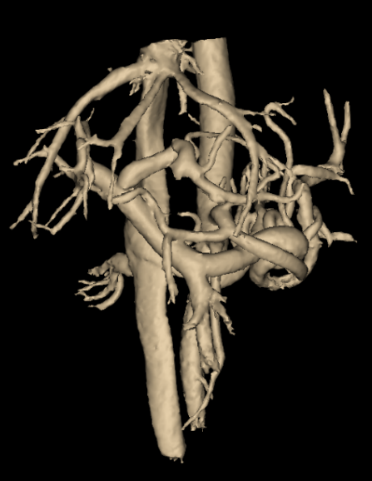
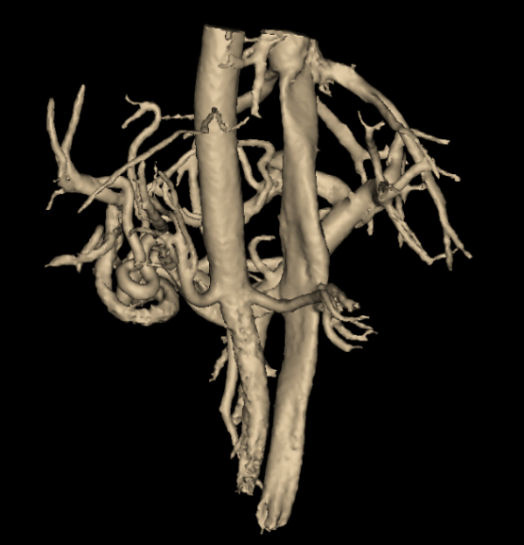
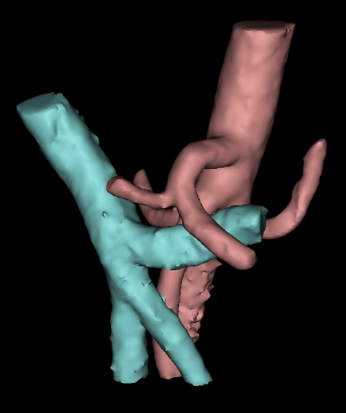
a)
b)
c)

Slide 5
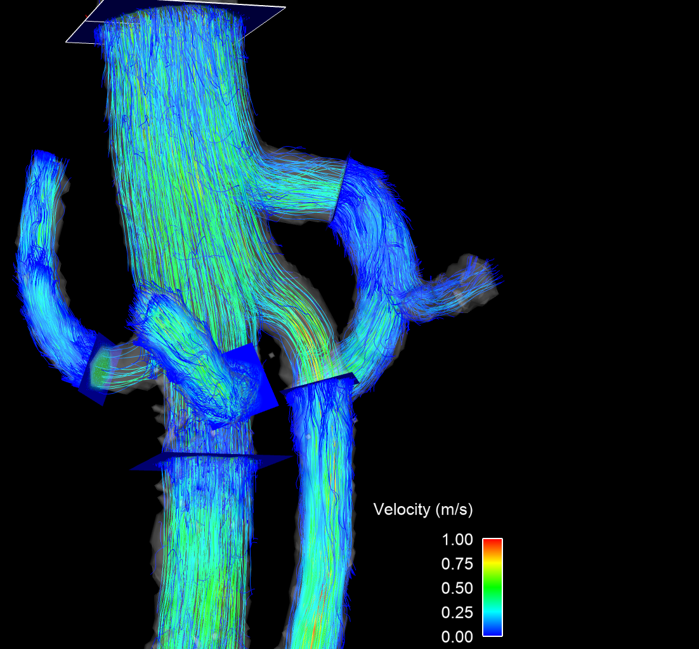
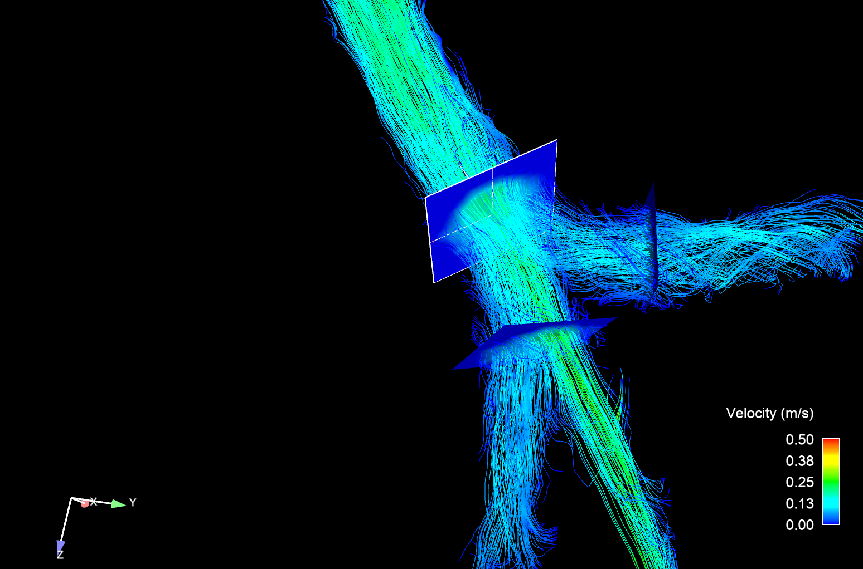
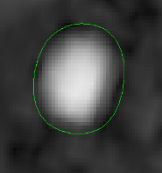
a)
b)
SCAo
PV
SV
ROI
LRA
CA
SMA
RRA
SMV
IRAo

Slide 7
*
*
[335%]
*
*
*

Slide 9
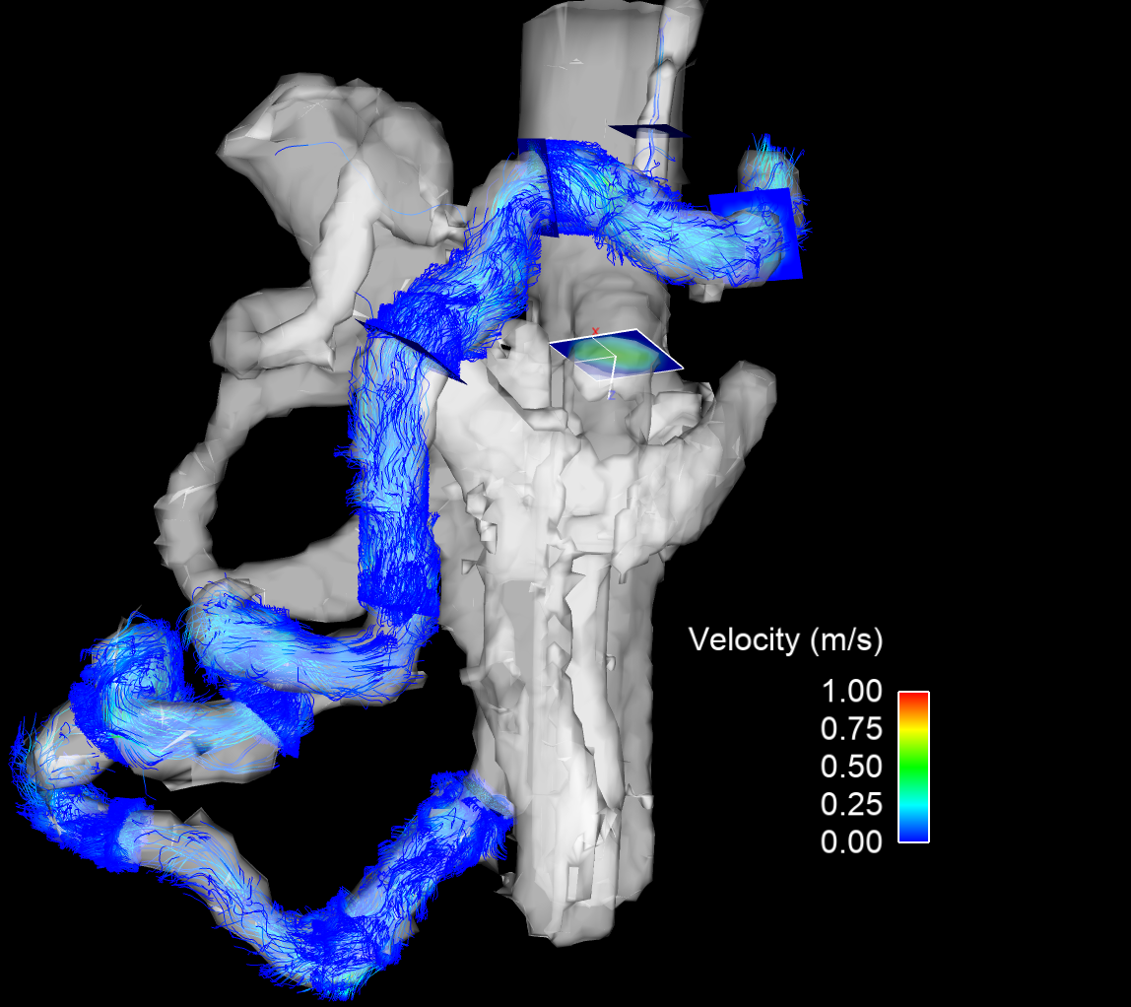
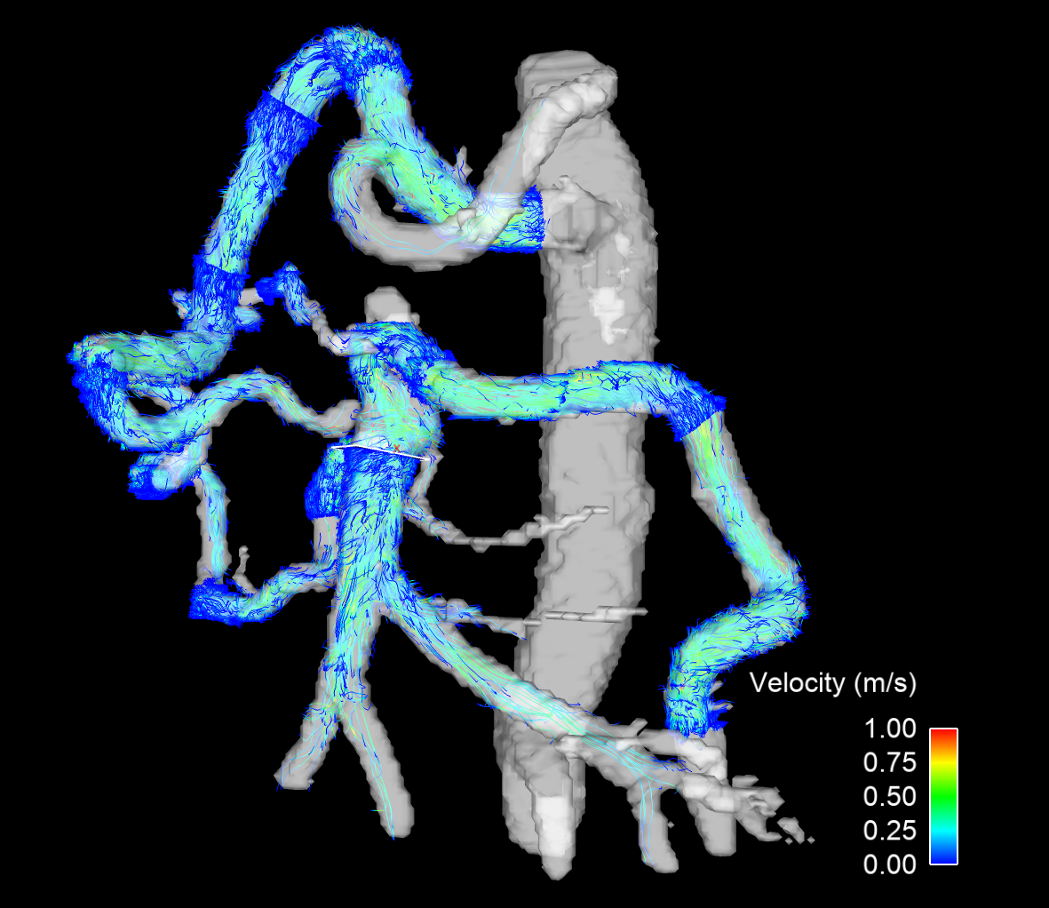
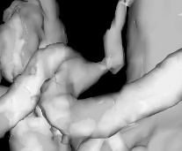
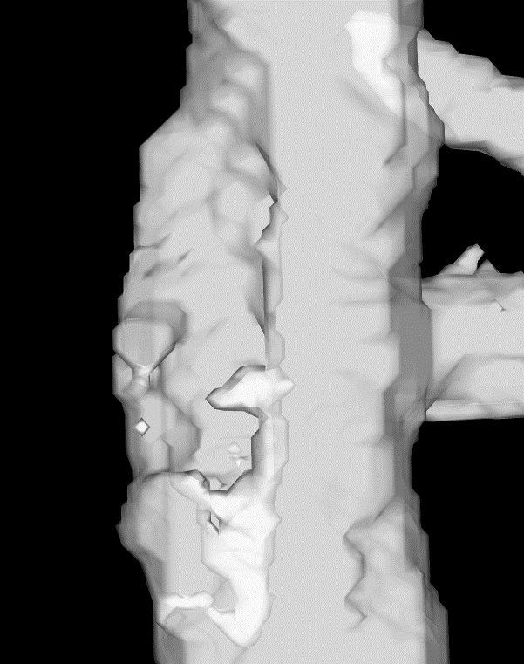
a)
b)
GDA
CA
GDA
Pancreatico-duodenal Arcade
CA Compression
Splenic Artery
Aortic Narrowing
SMA
SMA Occlusion
Distal SMA
Arc of Riolan
IMA

Slide 10
Table 1: Summarized Clinical, Diagnostic, and Follow-Up Findings for CMI+ subjects
No. | Clinical Findings | Diagnostic Test Findings | Procedures | Follow-Up | How was suspicion raised?
1 | Currently no symptoms; however, abnormal US findings with suspicion of mesenteric ischemia. | US: CA, SMA occlusion. Increase in systolic/diastolic velocity in IMA. MRI: Stable CA and SMA occlusion, reconstitution via pancreaticoduodenal and IMA collaterals. 70% narrowing of the IMA origin. | Conservative therapy | Patient remained asymptomatic despite pathological imaging findings. Therapeutic endarterectomy of IMA and bypass to the SMA were proposed, however, patient remained reluctant to pursue the operation. | Imaging
2 | Four weeks of diarrhea and weight loss, with left-sided postprandial chest pain. | CT: Narrowing of CA and SMA. MRI: Hemodynamically significant mesenteric ischemia due to CA and SMA stenosis. SMA stenosis worsened in comparison to previous imaging. | SMA and CA PTA with stenting | Postprocedural, symptoms resolved completely. | Symptoms/Imaging
3 | Chronic abdominal discomfort and postprandial pain, nausea, vomiting. | CT: Mild SMA and CA stenosis. MRI: Moderate to severe stenosis at origin of SMA and mild stenosis at origin of CA. | Transaortic endarterectomy with mesenteric artery revascularization | Postprocedural, symptoms decreased. | Symptoms/Imaging
4 | Abdominal pain, known Stanford type B aortic dissection. | CT: Stanford type B aortic dissection. CA with moderate to severe narrowing. MRI: Stable Stanford type B aortic dissection. Moderate to severe CA stenosis at the origin. | Conservative therapy | Acute abdominal pain improved under conservative therapy. No symptoms indicating chronic SAM ischemia. | Imaging
5 | Nausea and weight loss. History of thoracoabdominal aneurysm repair, with little to no SMA flow noted during surgery. | MRI: Aortic repair. Widely reimplanted CA and IMA, occlusion of SMA with collateral flow. Abnormal flow through the splenic artery, increase in splenic size, and relative flow mismatch to mesenteric arteries, suggestive of mesenteric steal phenomenon. | Conservative therapy | Release of symptoms under conservative therapy of transfusion related hemolytic anemia. | Symptoms/Imaging
6 | Weight loss, chronic postprandial pain. History of extensive vascular disease with known CA stenosis. | MRI: Nonspecific narrowing of proximal CA with distal reconstitution by gastroduodenal artery. | Median arcuate ligament surgical release | Postprocedural, complete resolution of postprandial pain. Patient was additionally diagnosed with Takayasu arteritis treated by prednisone. | Symptoms/Imaging
Abbreviations: CA=celiac artery; SMA=superior mesenteric artery; IMA=inferior mesenteric artery; CT=computed tomography; MRI=magnetic resonance imaging; US=ultrasound; PTA=percutaneous transluminal angioplasty; SAM=segmental arterial mediolysis;

Slide 11
Table 4: Average Volumetric Flow Rates (mL/min/kg)
Vessel |  | Control | CMI- | CMI+
SCAo | Pre- Flow (mL/min/kg) | 48.2 ± 17.6 | 42.0 ± 12.8 | 43.2 ± 18.9
 | Post- Flow (mL/min/kg) | 55.3 ± 19.9 | 49.5 ± 14.9 | 48.0 ± 32.7
IRAo | Pre- Flow (mL/min/kg) | 15.5 ± 7.81 | 16.5 ± 6.39 | 19.7 ± 3.85
 | Post- Flow (mL/min/kg) | 14.0 ± 6.15 | 17.3 ± 5.33 | 20.2 ± 7.36
LRA | Pre- Flow (mL/min/kg) | 5.00 ± 3.40 | 5.92 ± 2.54 | 4.60 ± 3.61
 | Post- Flow (mL/min/kg) | 4.94 ± 2.91 | 5.79 ± 2.27 | 4.29 ± 4.43
RRA | Pre- Flow (mL/min/kg) | 4.85 ± 2.42 | 5.43 ± 2.25 | 7.18 ± 6.38
 | Post- Flow (mL/min/kg) | 5.21 ± 2.72 | 5.17 ± 2.04 | 5.87 ± 6.28
SMA | Pre- Flow (mL/min/kg) | 5.97 ± 3.15 | 7.35 ± 3.73 | 8.84 ± 4.36
 | Post- Flow (mL/min/kg) | 11.1 ± 5.00 | 10.6 ± 4.66 | 11.2 ± 6.32
CA | Pre- Flow (mL/min/kg) | 11.8 ± 7.88 | 7.00 ± 3.79 | 7.29 ± 3.47
 | Post- Flow (mL/min/kg) | 11.0 ± 7.00 | 7.08 ± 4.80 | 8.11 ± 3.62
SMV | Pre- Flow (mL/min/kg) | 6.61 ± 2.66 | 6.24 ± 3.62 | 11.4 ± 3.79
 | Post- Flow (mL/min/kg) | 14.2 ± 4.56 | 14.2 ± 3.80 | 17.7 ± 9.87
SV | Pre- Flow (mL/min/kg) | 6.52 ± 4.18 | 6.12 ± 3.82 | 5.80 ± 2.33
 | Post- Flow (mL/min/kg) | 5.80 ± 2.52 | 5.87 ± 4.17 | 4.80 ± 1.76
PV | Pre- Flow (mL/min/kg) | 14.1 ± 5.57 | 13.2 ± 4.50 | 17.8 ± 5.22
 | Post- Flow (mL/min/kg) | 20.6 ± 5.91 | 21.3 ± 4.88 | 22.3 ± 10.3

Slide 12
Table 5: Average Percent Change in Flow and Number of Vessels Visualized

